Slide 1
ACL

Slide 2
What is ACL
ACL stands for Access Control List. It is used for controlling traffic across a network. You can block or allow packets by different filters.

Slide 3
Standard ACL
Standard ACL blocks traffic by using the source IP. It used less commonly than extended ACL or name ACL.

Slide 4
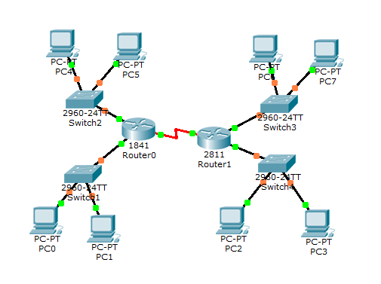
Standard ACL
We employed it in our example network.

Slide 5
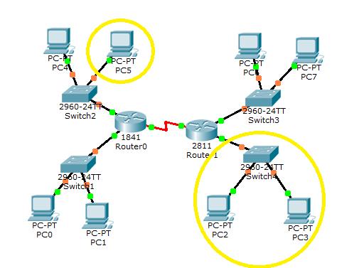
Standard ACL
The first access-list we instantiated was to block 10.0.0.3 from accessing the 40.0.0.0 network.

Slide 6
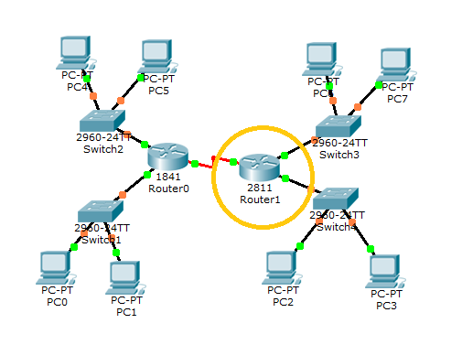
Standard ACL
The best place to place the ACL will be in Router1 at the port that network 40.0.0.0 is located.

Slide 7
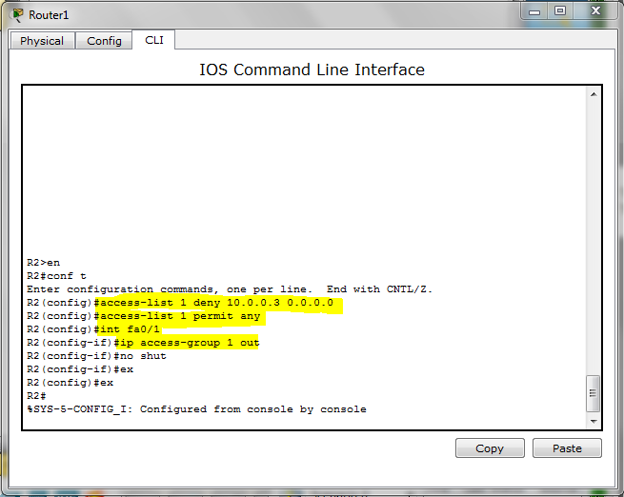
Standard ACL
Now we configure a access-list. We must add a rule to deny packets originating at 10.0.0.3, then to permit the rest. Next we assign the list to the correct port.

Slide 8
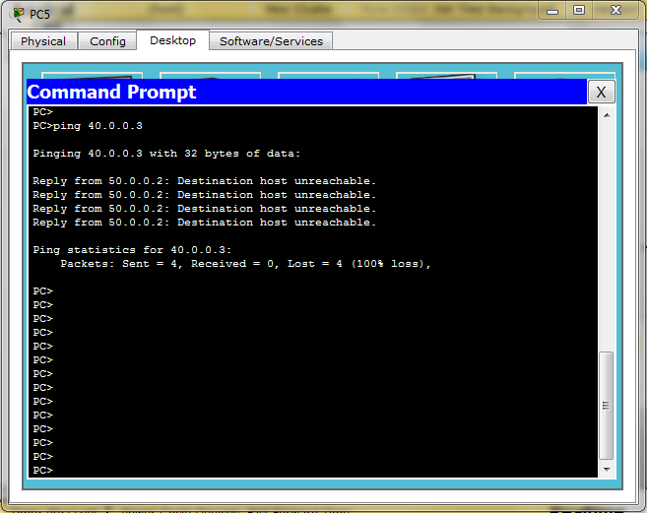
Standard ACL
Now we need to test it. We will go to the command prompt at the computer with 10.0.0.3 and attempt to ping something inside the 40.0.0.0 network.

Slide 9
Extended ACL
Extended ACLs provide a much broader range of flexibility. They perform the check as the standard and more, such as destination, protocals, and port number.

Slide 10
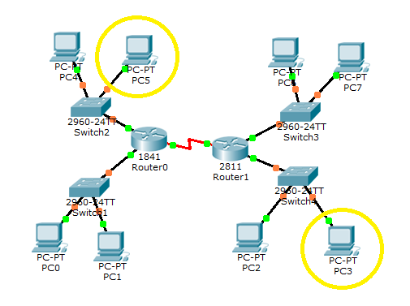
Extended ACL
Block host 10.0.0.3 to host 40.0.0.3
(10.0.0.3 should be able to reach all other hosts except 40.0.0.3)

Slide 11
Extended ACL
Block host 10.0.0.3 to host 40.0.0.3:
R1(config)#access-list 101 deny ip host 10.0.0.3 40.0.0.3 0.0.0.0 R1(config)#access-list 101 permit ip any any R1(config)#interface fastEthernet 0/0 R1(config-if)#ip access-group 101 in

Slide 12
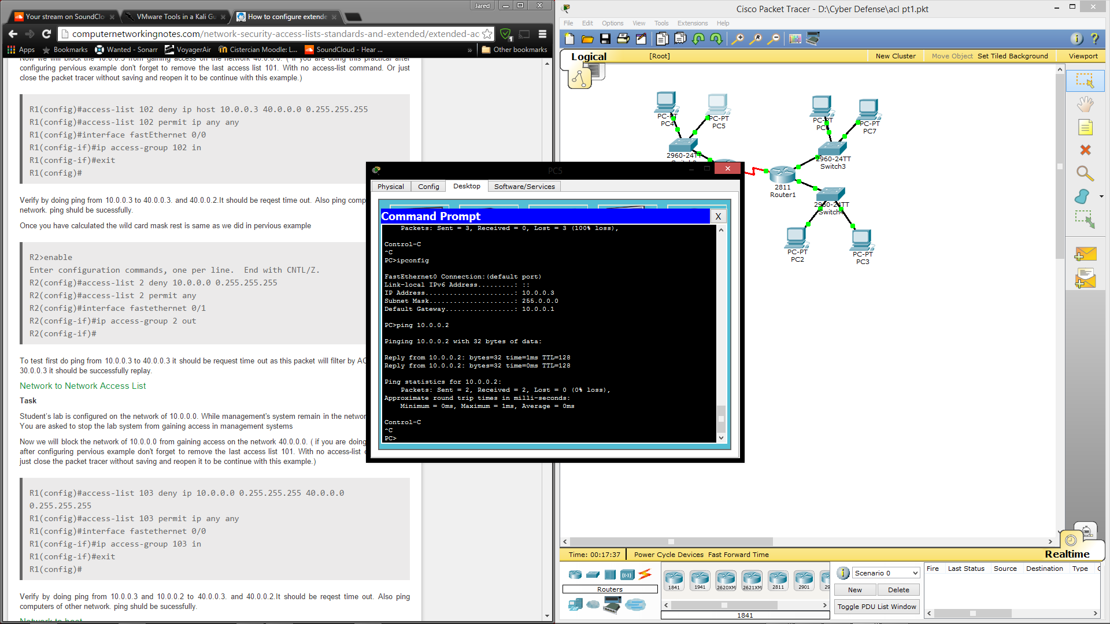



Slide 13
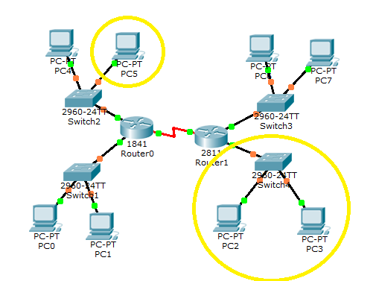
Extended ACL
Block host 10.0.0.3 to network 40.0.0.0
(This blocks the host 10.0.0.3 from connecting to any other host on the 40.0.0.0 network)

Slide 14
Extended ACL
Block host 10.0.0.3 to network 40.0.0.0
R1(config)#access-list 102 deny ip host 10.0.0.3 40.0.0.0 0.255.255.255 R1(config)#access-list 102 permit ip any any R1(config)#interface fastEthernet 0/0 R1(config-if)#ip access-group 102 in

Slide 15
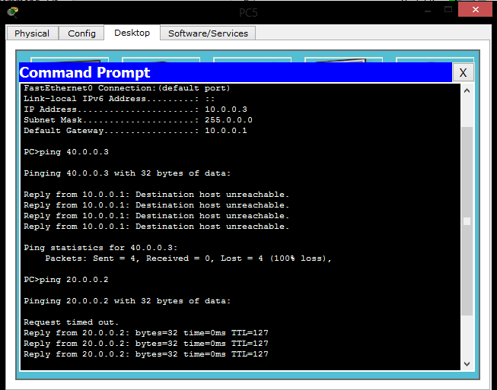

Slide 16
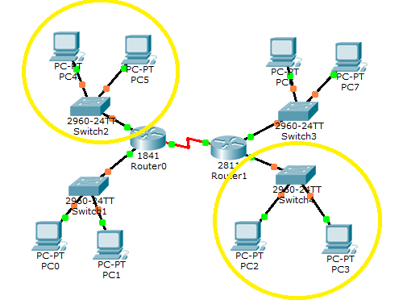
Extended ACL
Block Network 10.0.0.0 to network 40.0.0.0
(This blocks all hosts on 10.0.0.0 from connecting with all hosts on 40.0.0.0)

Slide 17
Extended ACL
Block Network 10.0.0.0 to network 40.0.0.0
R1(config)#access-list 103 deny ip 10.0.0.0 0.255.255.255 40.0.0.0 0.255.255.255 R1(config)#access-list 103 permit ip any any R1(config)#interface fastethernet 0/0 R1(config-if)#ip access-group 103 in

Slide 18
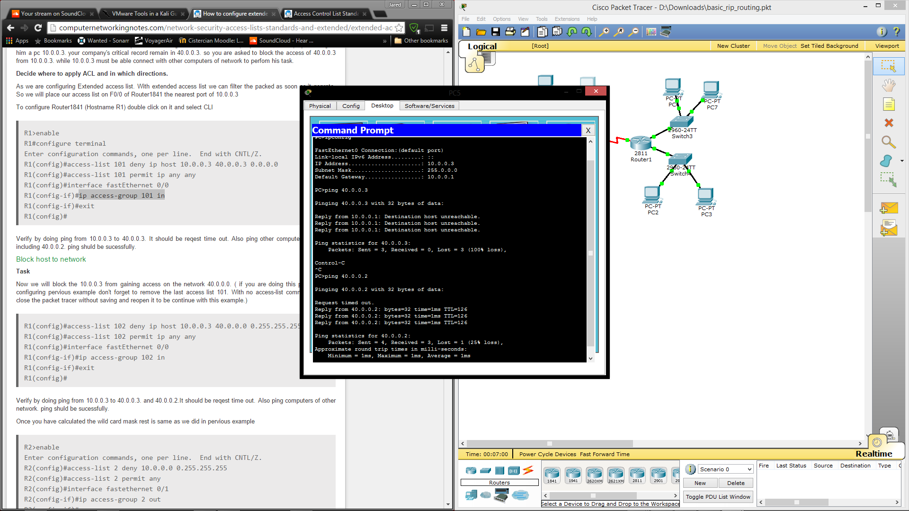


Slide 19
Extended ACL
Block 10.0.0.0 to host 40.0.0.3
R1(config)#interface fastethernet 0/0 R1(config-if)#no ip access-group 103 in R1(config-if)#exit R1(config)#no access-list 103 deny ip 10.0.0.0 0.255.255.255 40.0.0.0 0.255.255.255 R1(config)#access-list 104 deny ip 10.0.0.0 0.255.255.255 40.0.0.3 0.0.0.0 R1(config)#access-list 104 permit ip any any R1(config)#interface fastethernet 0/0 R1(config-if)#ip access-group 104 in
Basically the opposite of the second one

Slide 20
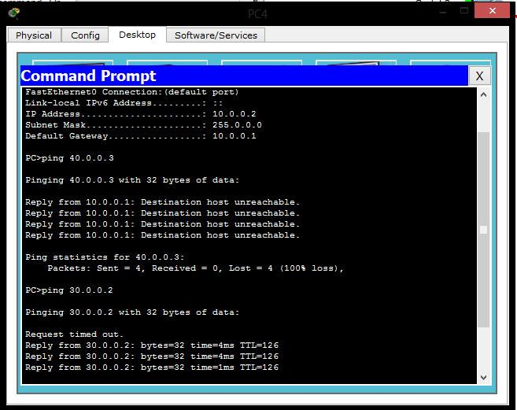

Slide 21
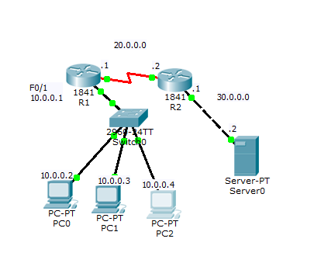
Extended ACL with Server
Allow only 10.0.0.2 to telnet to the server

Slide 22
Extended ACL with Server
Allow only 10.0.0.2 to telnet to the server
R1(config)#access-list 104 permit tcp host 10.0.0.2 30.0.0.2 0.0.0.0 eq 23 R1(config)#access-list 104 deny tcp 10.0.0.0 0.255.255.255 30.0.0.2 0.0.0.0 eq 23 R1(config)#access-list 104 permit ip any any R1(config)#interface fast 0/1 R1(config-if)#ip access-group 104 in

Slide 23
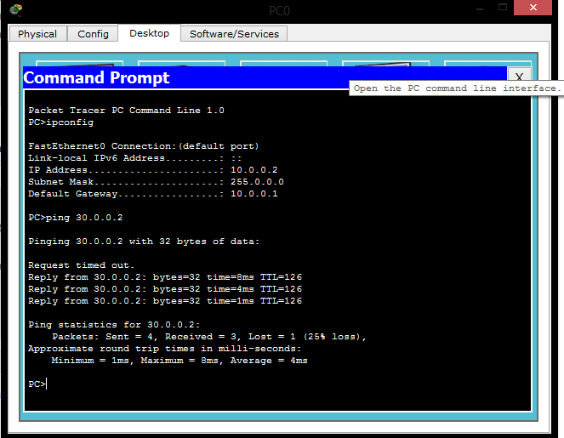

Slide 24
Extended ACL with Server
Allow only 10.0.0.3 ftp access

Slide 25
Extended ACL with Server
Allow only 10.0.0.3 ftp access
R1(config)#access-list 103 permit tcp host 10.0.0.3 30.0.0.2 0.0.0.0 eq 20 R1(config)#access-list 103 permit tcp host 10.0.0.3 30.0.0.2 0.0.0.0 eq 21 R1(config)#access-list 103 deny tcp any any eq 20 R1(config)#access-list 103 deny tcp any any eq 21 R1(config)#access-list 103 permit ip any any R1(config)#interface fastethernet 0/1 R1(config-if)#ip access-group 103 in

Slide 26
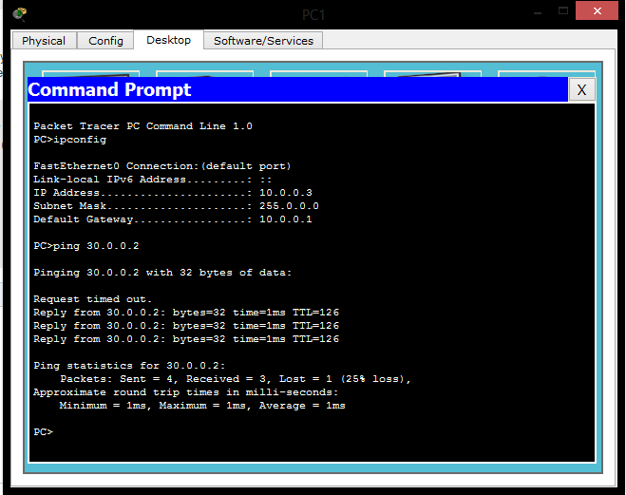

Slide 27
VLANS
Virtual local area networks are used to connect end devices as if they were on the same physical local network.

Slide 28
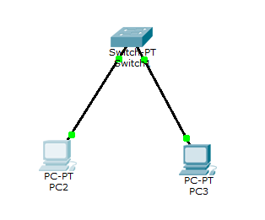
VLANS
To build a simple demonstration of VLANs place two computers connected to a switch.

Slide 29
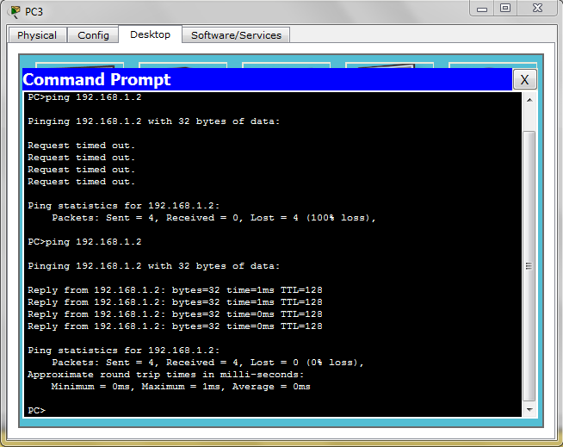
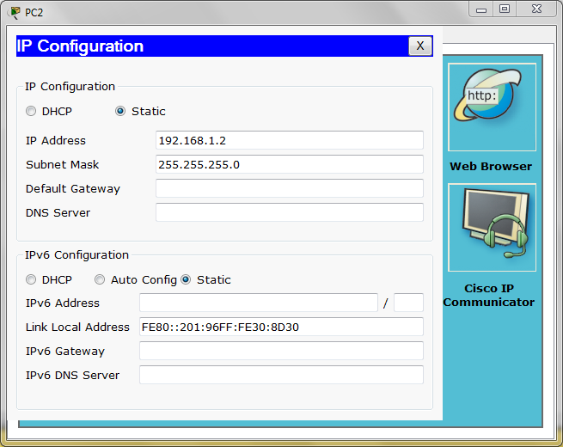
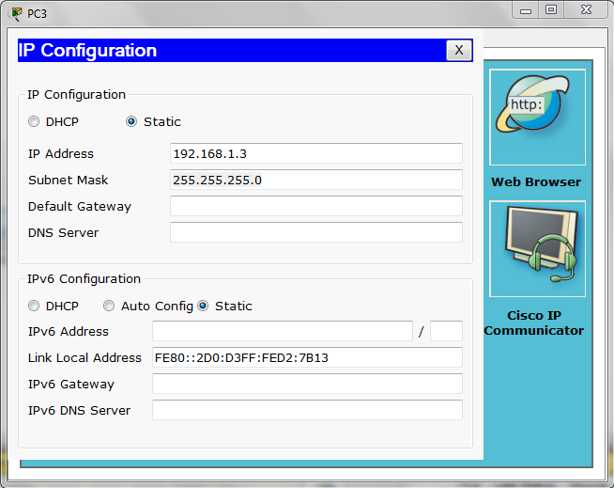
VLANS
Configure them to successfully ping each other.

Slide 30
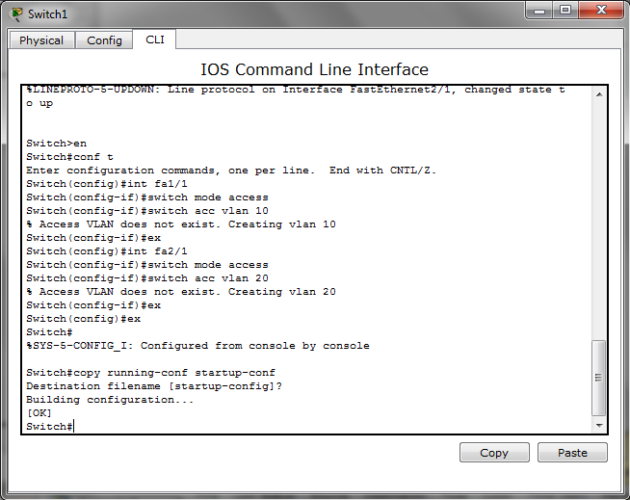
VLANS
Next you need to assign each computer to its own VLAN
Open the router CLI and type in the commands shown.

Slide 31
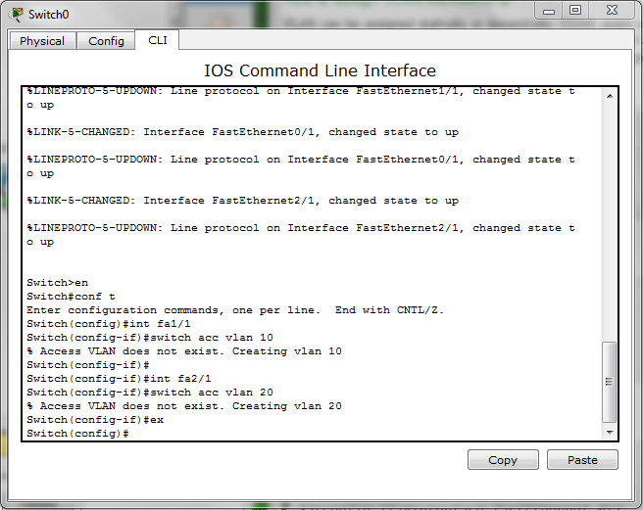
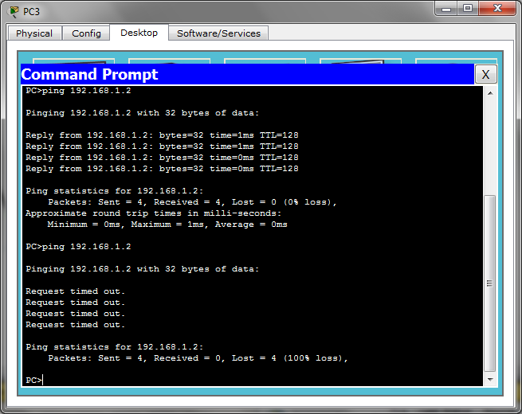
VLANS
Now each computer is on its own VLAN. They cannot see each other.

Slide 32
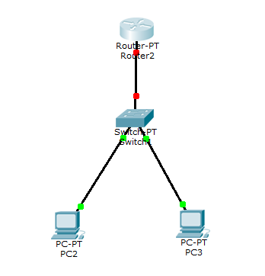
VLANS
To allow the computers to see each other, connect the VLANs, the same as one would with two regular LANs, with a router.

Slide 33
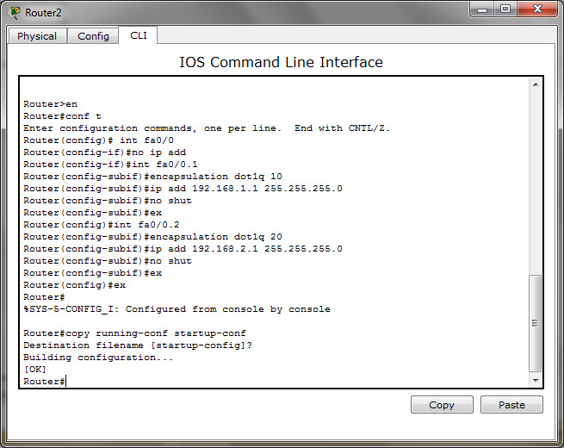
VLANS
Now, since this is essentially two networks which would normally require two cable, you must split the single cable to act as two. Then each section must be configured as if it was a seperate cable and port.

Slide 34
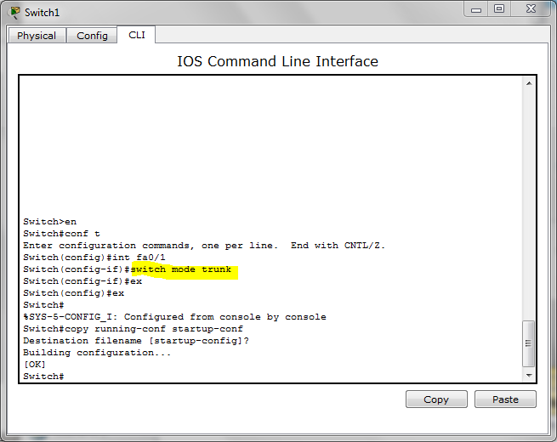
VLANS
Next we need to tell the switch to set the port to trunk

Slide 35

VLANS
Finally change the second computer’s IP to the second network format.
(192.168.2.2)

Slide 36
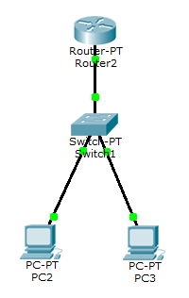

VLANS
Now they can see each other and can successfully ping.

Slide 37
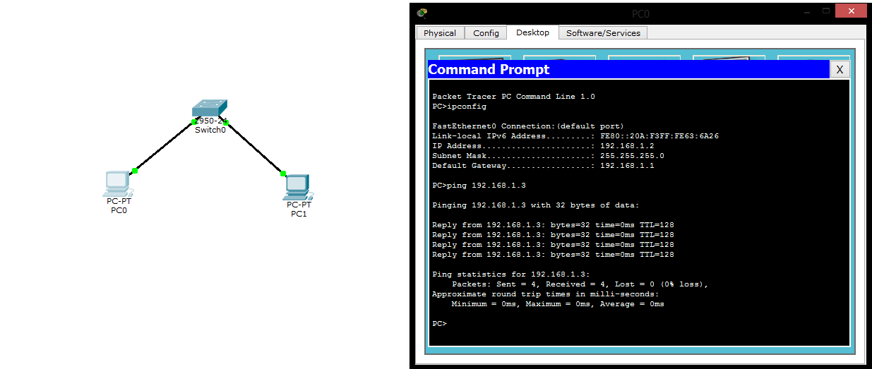
LAB 3
Connect 2 computers to the switch and configure them to ping each other:
Set IPs for each computer
Ping one computer from another

Slide 38
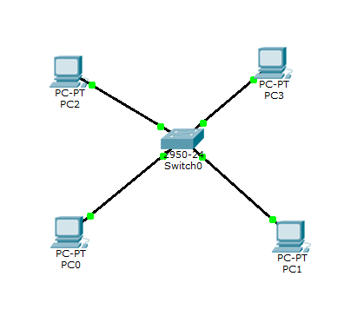
LAB 3
Create 2 vlans in 1 switch and put computers in each of the vlans:
Switch(config)#vlan 10
Switch(config-vlan)#name BOSS //your desired VLAN name
Switch(config-vlan)#exit
Switch(config)#vlan 20
Switch(config-vlan)#name MARKETING //your desired VLAN name
Switch(config-vlan)#exit
(press ctrl-z)
Switch(config)#interface f0/1 //you can shorten the command to int f0/1, f0/1 is the port where the PC is connected to.
Switch(config-if)#switchport access vlan 10
Switch(config-if)#exit
Switch(config)#interface f0/2
Switch(config-if)#switchport access vlan 10
Switch(config-if)#exit
Switch(config)#interface f0/3
Switch(config-if)#switchport access vlan 20
Switch(config-if)#exit
Switch(config)#interface f0/4
Switch(config-if)#switchport access vlan 20
Switch(config-if)#exit
(press ctrl-z)
Switch#
7. Set the IP address for each PC, for example:
PC 1 VLAN 10 = 10.10.10.1
PC 2 VLAN 10 = 10.10.10.2
PC 3 VLAN 20 = 20.20.20.1
PC 4 VLAN 20 = 20.20.20.2

Slide 39
Router on a Stick
Also known as a “one-armed router”, a router on a stick is a configuration in which the router only has one physical or logical connection to a network. This configuration is useful for forwarding traffic between locally attached hosts on separate logical routing domains or facilitating routing table administration, distribution, and relay.

Slide 40
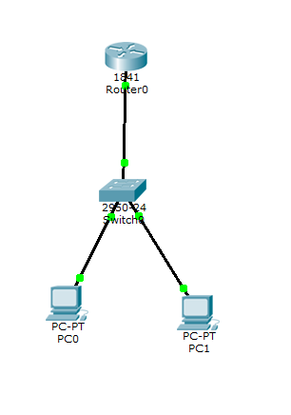
Router on a Stick
First configure 2 vlans on a switch like we did earlier:
Enter configuration commands, one per line. End with CNTL/Z.
Switch(config)#vlan 10
Switch(config-vlan)#name BOSS //your desired VLAN name
Switch(config-vlan)#exit
Switch(config)#vlan 20
Switch(config-vlan)#name MARKETING //your desired VLAN name
Switch(config-vlan)#exit
(press ctrl-z)
Switch(config)#interface f0/1 //you can shorten the command to int f0/1, f0/1 is the port where the PC is connected to.
Switch(config-if)#switchport access vlan 10
Switch(config-if)#exit
Switch(config)#interface f0/2

Slide 41
Router on a Stick
Next we configure the switch and set the interface between the switch and the router to trunk mode
SW1#config t
SW1(config)#vlan 10
SW1(config-vlan)#vlan 20
SW1(config-vlan)#exit
The fastethernet (fa0/3) will be set to trunk mode:
SW1(config)#interface fa0/3 SW1(config-if)#switchport mode trunk
SW1(config-if)#end
fa0/3 set to trunk mode

Slide 42
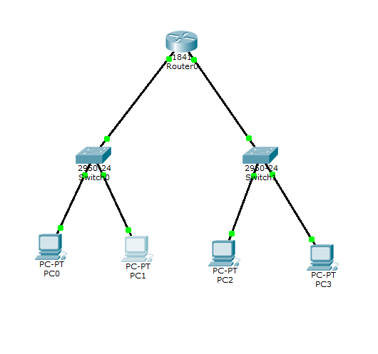
More VLAN Configurations
Make 2 vlans on each switch
Use same process we previously used to configure 2 new vlans and then the switch and the router

Slide 43
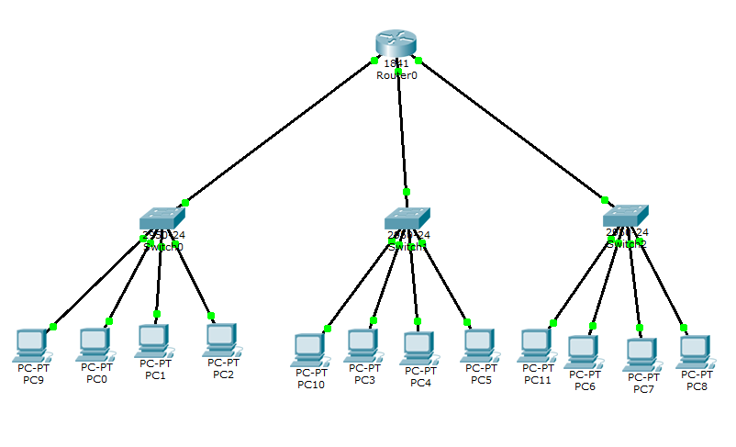
More VLAN Configurations
Make a network with 3 switches and 4 vlans with 3 computers attached to each vlan
Repeat the same processes to add 4 vlans per switch and configure the router with 3 trunk ports
vlan1
vlan2
vlan3
vlan4

Slide 44
Resources
http://computernetworkingnotes.com/network-security-access-lists-standards-and-extended/standard-access-lists.html
http://computernetworkingnotes.com/network-security-access-lists-standards-and-extended/extended-access-list.html
http://hxr99.blogspot.com/2013/03/cisco-packet-tracer-building-vlan.html
https://learningnetwork.cisco.com/docs/DOC-23481
http://www.orbit-computer-solutions.com/How-to-Configure-Router-on-a-Stick-InterVLAN-Routing.php
http://tecexpertz.com/connect-2-routers-step-by-step-static-routing/
http://en.wikipedia.org/wiki/One-armed_router
Lectures
Julian

